Slide 2
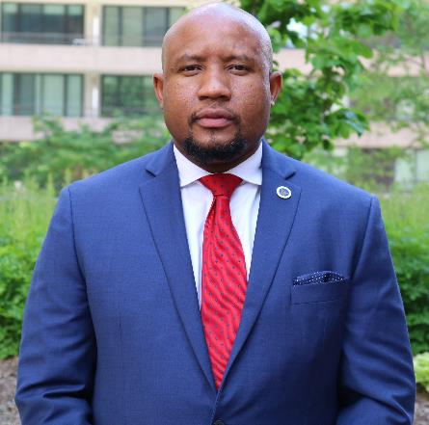
Mr. Gabriel Daniels, M.Sc., CASP
Cybersecurity Program Manager, Chinook Systems Inc.
More than 12 years of experience in hardware, software and networking technologies focused in Information Assurance
Leads Chinook’s CyberCx™ division
Supports Chinook clients in the implementation and maturation of their cybersecurity programs for information technology (IT) and operational technology (OT)
Develops cybersecurity policies and establishes continuous monitoring programs to assess the extent to which those policies are implemented

Slide 3
The Problem

Slide 4
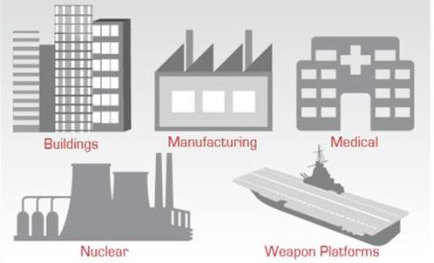
The Problem
Information security breaches are becoming more difficult to detect.
The average number of days that a breach goes undiscovered is now over 300 days.

Slide 5
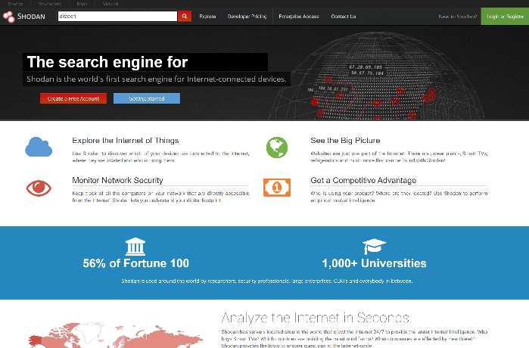
To Help Underline How Close the Problem Is…
Go to: shodan.io
In the search bar, type in:
distech
Cyber Attacks Maps
https://cybermap.Kaspersky.com
https://www.fireeye.com/cyber-map/threat-map.html

Slide 6
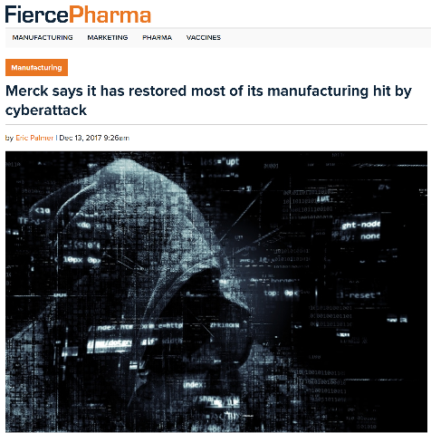
Cybersecurity War Story #1
Merck, a global pharmaceutical firm, was targeted by a cyberattack against its manufacturing network.
The Petya ransomware, similar to a worm-cyberattack, “infiltrated Microsoft systems that had not installed a needed security patch, taking control of computers and seeking a ransom in order for users to take back control.”
The result:
  Impaired delivery of pharmaceuticals
  Approximately $300 million in lost sales and costs
  6 months to restore the majority of the manufacturing/packaging process to its original status
  Forced dependency on 3rd party (CDC) for fulfilling orders for vaccinations
Source: https://www.fiercepharma.com/manufacturing/merck-says-its-has-restored-most-its-manufacturing-hit-by-cyber-attack

Slide 7
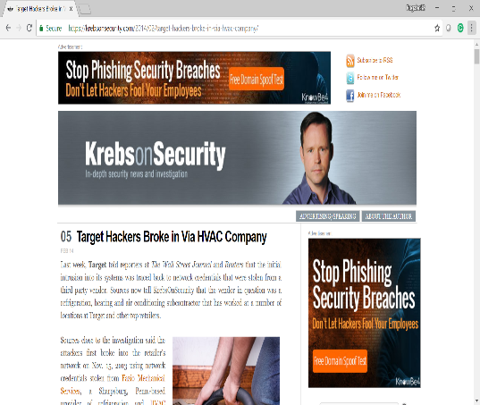
Cybersecurity War Story #2
Target, the second largest department store in the United States was hacked via 3rd Party HVAC vendor, and the breach cost over $162 million.
Cybercriminals first broke into the retailer’s network on November 15, 2013 using network credentials stolen from Fazio Mechanical Services, a Sharpsburg, Pennsylvania based provider of refrigeration and HVAC systems.
Between November 15 and November 28, the attackers succeeded in uploading their card stealing malicious software to a small cash registers and test the vulnerability of point-of-sale devices
The result:
  Exposed over 40 million debit and credit card accounts between November 27 and December 15, 2013.
  Attack affected Target Brand
Source: https://krebsonsecurity.com/2014/02/target-hackers-broke-in-via-hvac-company/

Slide 8
Risk Management
Framework (RMF)

Slide 9
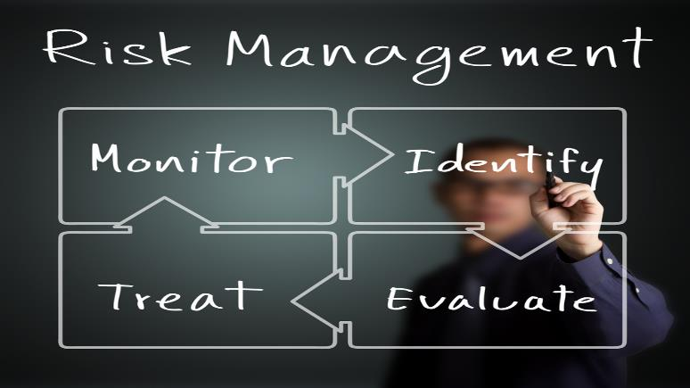
What is the Risk Management Framework(RMF)?
It’s a framework that provides a structured and disciplined approach to manage risk across all systems and platforms of an organization.

Slide 10

Why do we need RMF?
The Risk with
Connected Facilities

Slide 11

The Steps of the RMF Process
Step 1) Categorize
Categorize the system
Initiate Security Plan
Register system with DoD Component Cybersecurity Program
Assign RMF roles
Step 2) Select Controls
Common Control Identification
Select security controls
Develop continuous monitoring strategy
Review and approve security plan and monitoring strategy
Apply overlays and tailor – MAKE IT WORK FOR YOUR SYSTEM
Notes:
Categorize the system in accordance with the CNSSI 1253
Initiate the Security Plan
Register system with DoD Component Cybersecurity Program
Assign qualified personnel to RMF roles
Step 2) Select Controls
Common Control Identification
Select security controls
Develop system-level continuous monitoring strategy
Review and approve security plan and continuous monitoring strategy
Apply overlays and tailor

Slide 12

The Steps of the RMF Process
Step 3) Implement Controls
Implement control solutions consistent with DoD Component Cybersecurity Solutions
Document security control implementation in Security Plan
Step 4) Assess Controls
Develop and approve Security Assessment Plan
Assess security controls
SCA prepares Security Assessment Report (SAR)
Conduct initial remediation actions
Notes:
Step 3) Implement Controls
Implement control solutions consistent with DoD Component Cybersecurity Solutions
Document security control implementation in Security Plan
Step 4) Assess Controls
Develop and approve Security Assessment Plan
Assess security controls
SCA prepares Security Assessment Report (SAR)
Conduct initial remediation actions

Slide 13

The Steps of the RMF Process
Step 5) Authorize Controls
Prepare the POA&M
Submit Security Authorization Package (Security Plan, SAR and POA&M)
AO conducts final risk determination
AO makes authorization decision
Step 6) Monitor Controls
Determine impact of changes to the system and environment
Assess selected controls annually
Conduct needed remediation
Update Security Plan, SAR and POA&M
Report security status to AO
AO reviews reported status
Implement system decommissioning strategy

Slide 14

Roles and responsibilities of RMF Process
Information System Owner (ISO):
    The ISO is responsible for the full life-cycle of an Information System (IS).
Information System Security Manager (ISSM):
    This is the principal advisor on all matters involving the security of an IS under his/her purview.
Notes:
Information System Owner (ISO): This cycle includes the procurement, development, integration, modification, operation, maintenance and disposal of the IS. They also ensure the compliance of the IS with the information security requirements.
Information System Security Manager (ISSM): This includes technical and every other aspect of the security around an IS. They are also responsible to develop and update System Security Plans and other required RMF artifacts.

Slide 15

Roles and responsibilities of RMF Process
Facility Security Officer:
    Supports the ISSM in their efforts to implement security requirements for classified information systems.
Information System Security Officer (ISSO):
    Supports the ISSM in their efforts to implement security requirements as mandated by Federal regulations (NISPOM, DAAPM, NIST etc.).
Notes:
Facility Security Officer: Also ensures the physical and environmental protection, personnel security, incident handling, and security training and awareness.
Information System Security Officer (ISSO): Also configures and manage the IS configuration.

Slide 16

Identify
Protect
Detect
Respond
Recover
Asset management
Business environment
Governance
Risk assessment
Risk management strategy
Access control
Awareness and training
Data security
Information protection and procedures
Maintenance
Protective technology
Anomalies and events
Continuous security monitoring
Detection process
Response planning
Communications
Analysis
Mitigation
Improvements
Recovery planning
Improvements
Communications

Slide 17
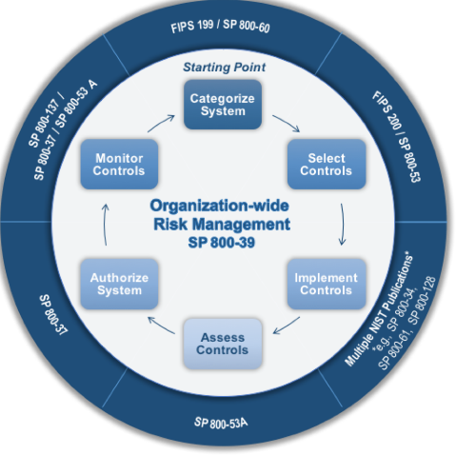
RMF Process Vs NIST CSF
The RMF Process follows the same basic approach as the NIST CSF:
CSF
RMF Process
Identify
Protect
Detect
Respond
Recover
Categorize
Select Controls
Implement Controls
Assess Controls
Authorize System
Monitor Controls

Slide 18


Contact Information
Chinook Systems, Inc.
Gabriel Daniels
Cybersecurity Program Manager
1235 S. Clark Street, Suite 500
Arlington, VA 22202
O: 571.527.0728 ext. 113
C: 703.955.2843
gdaniels@chinooksystems.com

