Slide 1
Cybersecurity
From an Axis Communications point of view.

Slide 2
Axis has a 100% focus on cybersecurity and we are doing everything in our power to mitigate risks.
Notes:
Axis is a manufacture of IT products. We are 100% committed to cybersecurity in our products

Slide 3

General recommendations
Account policy
Password policy
Keep system up to date
Mitigates
95%
of all risk
Notes:
Let’s start with some general recommendations that everyone should follow. You’ve probably heard these before. They’re very simple, but a lot of us still have problems with them.
Research shows that more than 95% of all successful breaches result from “a window of opportunity”.
Poor policies and processes provide these opportunities.
When you don’t lock your car or you hide your house key under the doormat, you create a window of opportunity that someone may want to use to break and enter. These are opportunistic attackers.
Audience participation: What are some common recommendations?
Good!
I will go through three of them.
Bullet 1: Account policy
Who is allowed to access the system and what privileges should they have?
Never give more privileges than a user needs. A user should never have administrator privileges.
Two reasons for this :
Reduce the risk of deliberate or unintentional misuse.
If the password is compromised, you are able to reduce the amount of damage an attacker can do.
Bullet 2: Password policy
Password policies are not only about password strength. It is also about how passwords are managed over time to reduce the risk of compromised passwords.
Bullet 3: Keeping your system up to date
A new critical vulnerability may be discovered tomorrow. When this vulnerability is known and the service is exposed, someone will eventually try to exploit it.
Following these recommendations will mitigate the risks of opportunistic attacks.

Slide 4

Small organizations
Recommendations
Follow general recommendations
Use passphrases
Don’t expose the camera to the internet
Notes:
Bullet 1: General recommendations
Once again, follow general recommendations: password, accounts and keeping the system updated.
Bullet 2: Passphrase
When people log into a system they struggle with strong obscure passwords. An obscure – strong – password will always end up written on a piece of paper. So our recommendation is to use a long passphrase that’s easy to remember but hard to guess. Axis cameras allow spaces in passwords.
Example: “my cat’s name is lucy and i love her so”. A 38 character long password – You can’t crack that!
Even written down it doesn’t look like a password.
Bullet 3: Internet exposure
This is the most common mistake that small organizations make. Small organizations usually want to be able to monitor video from anywhere.
There are a number of reasons why exposing a camera as a public web server is a bad idea. (Mirai botnet is one of them.)
For remote video access, we recommend using AXIS Companion. This Windows/iOS/Android client will give you remote video without exposing the camera. The video will also be encrypted.
You can read more about this solution at axis.com

Slide 5

Business organizations
Recommendations
Follow general recommendations +
Define a policy for video system
Basic risk assessment
Isolate video system (if possible)
Follow vendor guidelines
Notes:
Bullet 1: Define a Policy
A policy is always recommended that would include:
Who is allowed to access live or recorded video?
Who is allowed to manage users?
Who is allowed to configure and optimize the video system?
Who maintains the servers and devices?
Bullet 2: Risk assessment
Put some thoughts into threats and impact on video system. Ask questions like:
Who may want to attack the system and why?
How critical is video?
How is live and recorded video classified ( restricted, private or public)?
What if the video system goes down?
Bullet 3: Isolate network
A common recommendation is to isolate critical network assets. This will reduce the risk of them impacting each other.
Network isolation can be achieved with parallel networks or virtual networks known as VLAN.
If this is not possible you might add IP filtering on the cameras so they do not respond to untrusted clients.
Bullet 3: Follow vendor guidelines
Vendors should know their products and how they are used. A cybersecurity hardening guideline should be used.

Slide 6



Common mistakes that increase risk
Small business
Business organizations
Critical infrastructure
Exposing camera to the Internet
Poor physical protection
Poor cyber supply chain audit
Using default password
Single camera account
Bad passwords
Single server account
User applications installed on VMS server
No network isolation
Notes:
Common mistakes
Over the years, Axis has had the opportunity to gain insight into many video-system installations. What are the some common mistakes we see?
Small Organizations
1. Exposing camera to the internet
This is the number one mistakes small organizations make that has resulted in documented exploits. Exposing cameras to the internet exposes them to thousands of attackers. Axis used to describe how to configure the router, we have now changed our recommendations for accessing remote video.
2. Default passwords. Bad passwords are less risky if you are only operating on a small protected local network.
Business Organizations
Business organization are bigger and more is exposed more to more people.
1. Poor Physical protection:
Yes, you know what I am talking about. And yes, protection needs to be balanced with cost.
2. Single camera account (root)
Many video systems tend to use the camera root account as the daily operation account. And then, three months after deployment, everybody in the organization seems to know the camera’s root password. The root account has administrator privileges and people within the organization end up fiddling with the cameras.
Please, separate accounts with different privileges between administration and daily operation. Limit the root account to system administrators
3. Bad passwords
Yes, passwords again.
4. Single Windows account on VMS Server
As with cameras, only selected personnel should be able to log in as administrator. This applies to Windows servers hosting the VMS. Otherwise, after a few months, everybody in the organization has administrator privileges to a Windows server. Anyone who may need to log into the VMS Windows server host should have user privileges. This reduce the risk of “accidental misuse” that could compromise the Windows server.
5. User applications on a server
Running user applications such as an email client on a server is a bad idea.
The Washington DC police video system that became a victim of ransomware was most likely the result of an operator who used the VMS server to read email attachments or inserted USB-sticks. We do not know for certain as this case is still confidential.
6. No network isolation
Yes, we have already talked about this. Critical network resources should be isolated in case one network segmentation is compromised.
Critical Infrastructure Organizations
I am sure many mistakes are made - but they are often classified unless leaked to media.
However, the concerns around poor supply-chain-audits is increasing. When you’ve closed most doors, you need to reduce the risk of immature vendors adding or exposing unnecessary risks and vulnerabilities.
Axis is not perfect but we are actively working on strengthening our maturity and our offerings in the area of cybersecurity.
But if you ever feel we are not living up to expectations, please, let us know what your concerns are.

Slide 7
The end user’s responsibilities
Hardware and software maintenance
Paying for both !
Work with the internal IT
Stay away from cheap devices
Make an inventory !
Overall responsibility for organization’s cybersecurity (this can be transferred to consultants, etc.)
Notes:
Add graphic
You can’t blame the manufacture of the roofing shingle for the electrical power going out.
Can’t blame manufacture of the copper pipe for a bad connection leading to water destroying the electrical system.

Slide 8
The integrator’s responsibilities
Internal
Education & Training
Documentation
Secure own devices
External
Secure passwords
Remote monitoring
IT services
Misc.
Hire IT professionals

Slide 9
The manufacturer’s responsibilities
Process
Cyber Audit
ISO 27001
Supply Chain Mgmt
Documentation
Features
IEEE 802.1x
SSL/TLS
Encryption
etc.
Tools
Device Mgmt
Health Monitoring
Hardening Guide
Notes:
Our hardening guide is based off of IT industry security controls CSC.

Slide 10

Firmware Features (Cyber/Network)
Firmware 7.10
  LLDP*
  Password strength indicator
Firmware 7.20
  Default digest authentication
  HTTPS available from start with signed certificate
  OpenSSL and Apache web server updates
Firmware 7.30
  SRTP (ARTPEC-5)
  Disable FTP
  Brute force delay
Firmware 7.40
  SRTP (ARTPEC-6)
  Double confirmation on user set “weak” passwords
Firmware 8.10
  Apache web server update
Firmware 8.30
  Cybersecurity update for SMB/CIFS overall higher level of security by default
  Advance SD card encryption**
Notes:
OpenSSL to version 1.02k
Apache web server 2.4.25
Last year, for example, you can see the updates we made – this is a continuous, ongoing process – these are just the cybersecurity specific ones
SMB – Server Message Block
The SMB protocol was designed to allow computers to read and write files to a remote host over a local area network (LAN). The directories on the remote hosts made available via SMB are called “shares.”
CIF
CIFS stands for “Common Internet File System.” CIFS is a dialect of SMB. That is, CIFS is a particular implementation of the Server Message Block protocol, created by Microsoft.
SMB preferred more features especially in v2 and v3

Slide 11
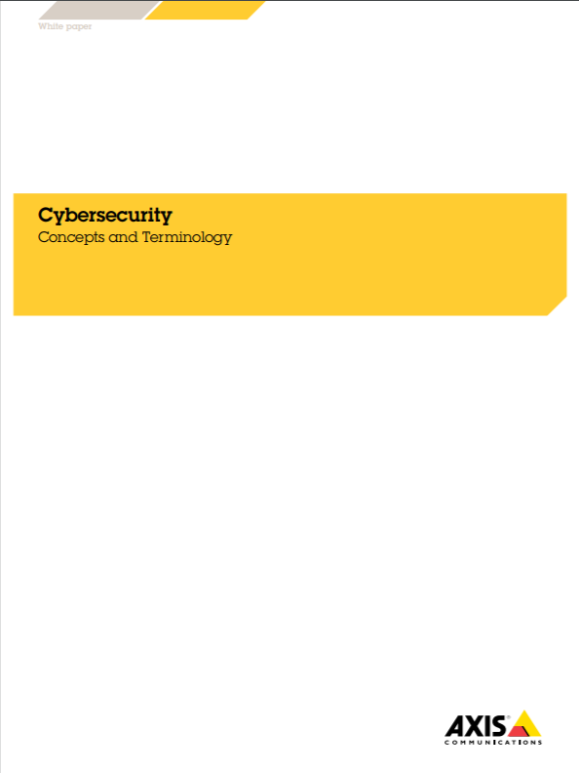
Education Tools
www.axis.com/support/product-security includes resources such as:
  Cybersecurity Concepts and Technology Guide
  Hardening Guide
  Vulnerability Policy
  Common Vulnerability and Exploits (CVE)
  Axis Academy Cybersecurity Online Course

Slide 12
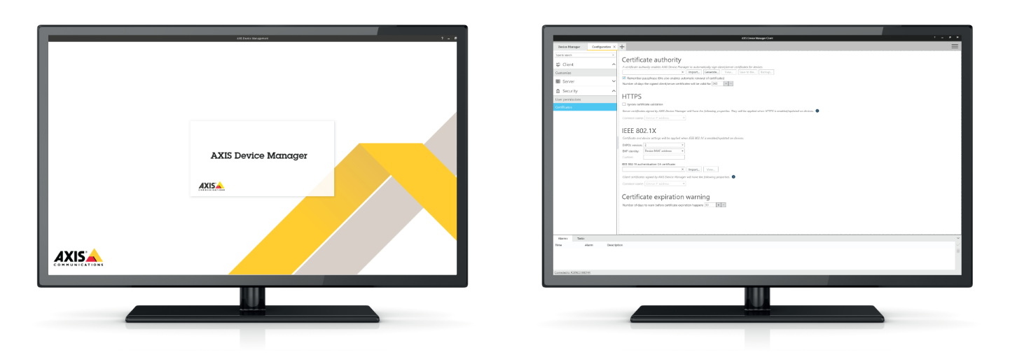
AXIS Device Manager
200 devices | Through web interface | Using ADM
Install ACAP | 400 minutes | 5 minutes
Upgrade firmware | 1000 minutes | 10 minutes
Configure devices | 4000 minutes | 10 minutes
Cyber harden | 1000 minutes | 5 minutes
∑ total | 106 hours | 30 minutes
Notes:
As many of you know already, it is much easier and faster to manage devices with ADM. In the end it is a large cost saving and a key differentiator for Axis.
This example shows some typical tasks made on 200 devices, with and with out ADM. Instead of over 100 hours you will do the same task in half an hour!!
I think this is really something to bring up in your discussions with the system integrators!

