Slide 1

Washington DC – Feb 16, 2017
DL Name(s)
Tim Tetreault CEM
DL Title(s) and Bio(s)
ESTCP Program Manager
Discussion Title
Topic 2: Innovative Approaches to Obtaining Authority to Operate for Facility-Related Control Systems.
Discussion Summary
Tim will give an overview of the ESTCP program and project call and open the discussion on how other federal, state and private sector organizations are addressing the challenge to design cybersecurity in from the beginning of the planning, design, construction and operations lifecycle. ESTCP projects are formal demonstrations in which innovative technologies are rigorously evaluated. ESTCP demonstrations are conducted at DoD facilities and sites to document improved efficiency, reduced liability, improved environmental outcomes, and cost savings.

Slide 2
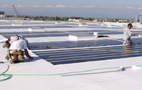
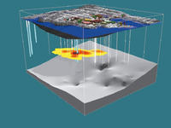
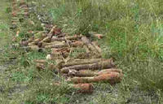

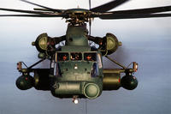
About ESTCP
Established in 1995 to:
  Improve DoD’s environmental performance
  Reduce costs
  Enhance and sustain mission capabilities
Demonstration & validation focus
Promote Implementation – Tech Transfer
Energy & Water is one of five ESTCP Program Areas
Issue annual solicitations.
Energy & Water
Environmental Restoration
Resource Conservation & Climate Change
Weapons Systems & Platforms
Munitions Response
Notes:
ESTCP is DoD’s environmental technology demonstration and validation program. The Program was established in 1995 to promote the transfer of innovative technologies that improve DoD’s environmental performance, reduce operational costs and enhance and sustain mission capabilities. ESTCP funds demonstration projects to validate technology cost and performance with the ultimate goal to transition successful technology to implementation and regulatory acceptance.

Slide 3
DoD Energy Use – ESTCP Focus
DoD Facility & Operational Energy Cost: $16.7B (FY15)
Military Installation Energy Consumption
ESTCP Test Bed Focus
3

Slide 4
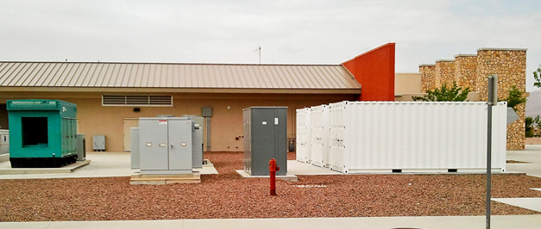
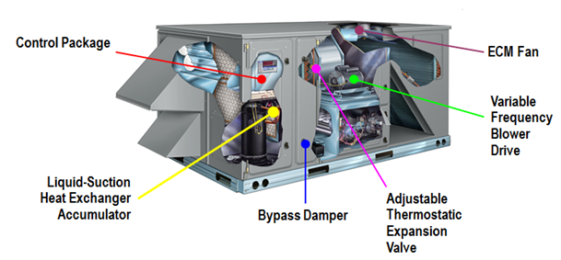
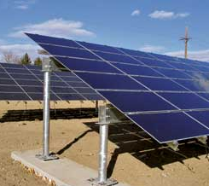
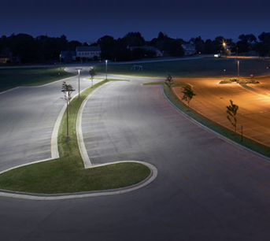
Energy and Water
Smart and secure installation energy management
  Microgrids
  Energy storage
  Ancillary service markets
  Cybersecurity
Efficient integrated buildings and components
  Design, retrofit, operate
  Enterprise optimized investment
  Advanced components
  Intelligent building management
  Non-invasive energy audits
Distributed generation
  Cost effective
  On-site
  Emphasis on renewables
Notes:
The Energy and Water Program covers a wide array of technologies that are applicable to use and management of energy and water on military installations. The technologies are organized in three main areas of focus. The first is “Smart and Secure Installation Energy Management”, which includes…, the Second is Efficient Integrated Buildings and Components, which includes…tech and tools that…and the Third is “Distributed Generation”, which includes renewables, waste heat recovery and CHP.

Slide 5
Completed EW Projects

Slide 6
ESTCP Methodology
Partner With Stakeholders and Test at DoD Facilities
  Developer, regulators, and end-user
  Direct transition
Validate Operational Cost and Performance
  Independent test and evaluation
  Satisfy regulatory and user communities
Identify DoD Market Opportunities
  Technology transfer

Slide 7
Project Requirements
Formal Demonstration Plans
  Detailed performance objectives
  Independent review
Execution of Technology Demonstration
  Collect cost and performance data
Written Reports on Cost and Performance
  Technical report
  Cost and performance summary report
Support for Transition
  Regulatory/end-user acceptance
  Guidance and training

Slide 8
ESTCP Solicitation Process
Department
of Defense Call
Broad Agency Announcement Call
Federal Organizations Outside DoD Call
Pre-Proposal
Full Proposal
Oral Briefing
Selections

Slide 9
ESTCP Solicitation Dates
ESTCP Solicitations Released | February 2, 2017
Pre-proposals Due | April 6, 2017, 2:00 p.m. Eastern Time
Full Proposal Requested | June 2017
Full Proposals Due | August 2017
Briefings Before ESTCP Technical Committee | September 2017
Project Selection | October 2017
Project Initiation | Spring 2018

Slide 10
Broad Agency Announcement and Call for Proposals for Federal Organizations Outside DoD
Call for Technologies
  Specific topic areas
Short Written Pre-Proposal
  Request full proposal (if selected)
  Modifications recommended
Identify DoD Liaisons
  Site Selection
  Technology Transition
Selection
  Full proposal
  Oral presentation

Slide 11
Selection Criteria
Relevance (Pass/Fail)
Appropriate for Demonstration (Pass/Fail)
Technical Merit
Cost/Benefit
Transition Potential
Cost
Small Business Participation (For BAA Full Proposal)

Slide 12
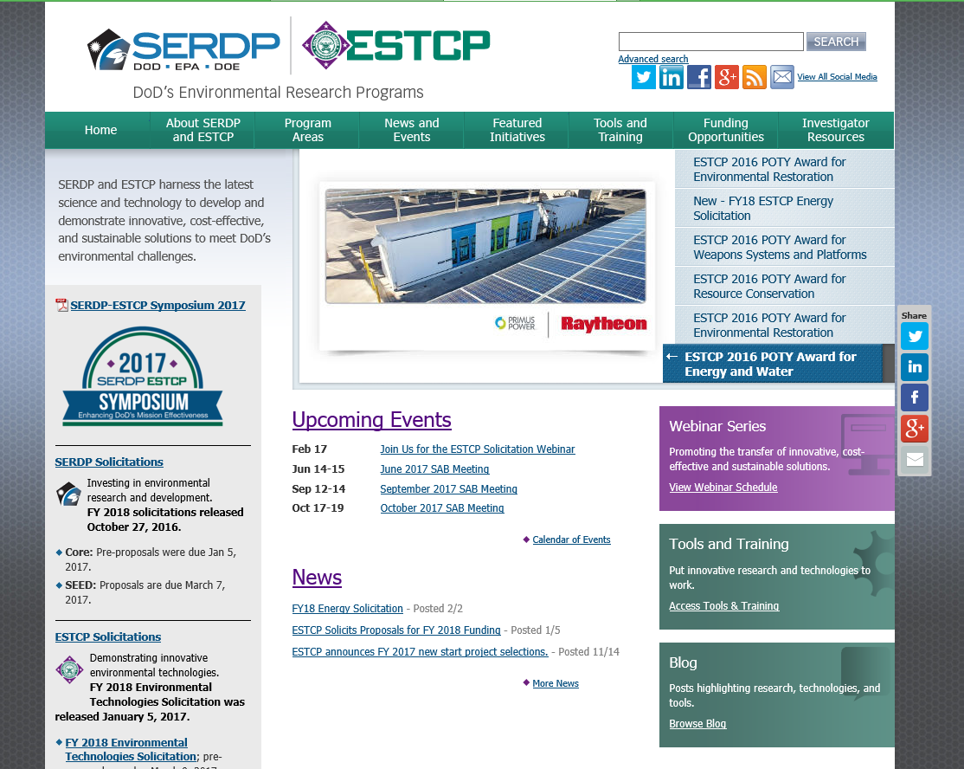
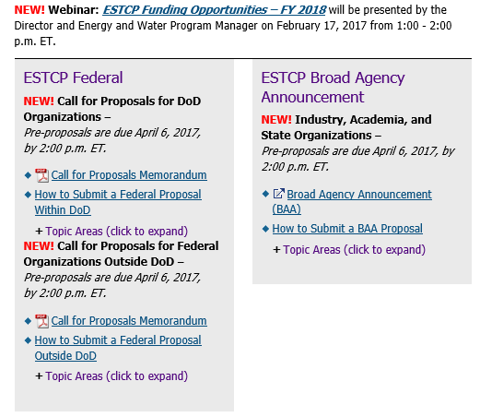
Website: www.serdp-estcp.org
ESTCP Solicitations
Installation Energy and Water Solicitation

Slide 13
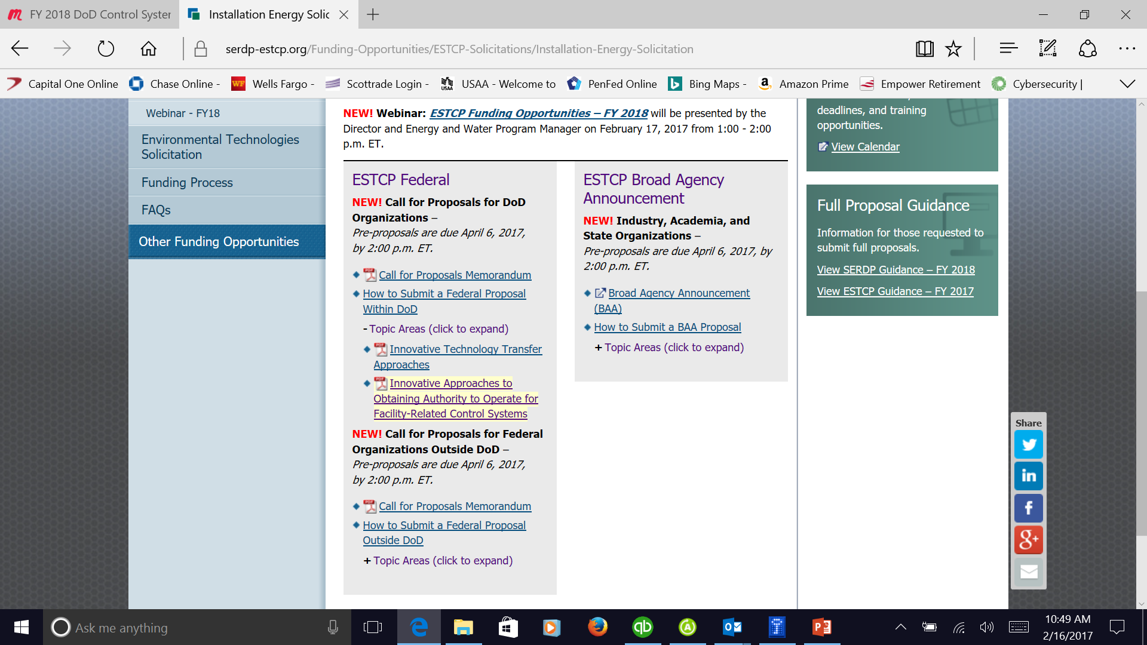
ESTCP Call For Proposals FY 2018
https://www.serdp-estcp.org/Funding-Opportunities/ESTCP-Solicitations/Installation-Energy-Solicitation

Slide 14
Facility-Related Control Systems and Energy Management
Many currently-installed facility energy control systems and devices are not providing their full benefit (operational efficiency and energy and cost savings) to DoD due to restrictions on network access and connectivity stemming from cyber security concerns. The process to gain Authority To Operate (ATO), a requirement for network connected systems and devices, can be cost-prohibitive and time consuming. The DoD Installation Energy Test Bed seeks innovative approaches to obtaining Authority To Operate (ATO) for common current and future network-reliant facility energy control systems and devices. Demonstrations must satisfy the requirements established in the Department of Defense Instruction (DoDI)[masked], Cybersecurity, and DoDI[masked], Risk Management Framework (RMF) for DoD Information Technology (IT) and any applicable Service-specific requirements. DoD seeks solutions that result in Type Authorization[1] (TA) and Reciprocity[2] and/or can be easily replicated by installation personnel responsible for this activity.
The FY 2018 project call builds on the FY 2017 project call: Cybersecurity and Its Impact on Installation Energy Management.
1 Type Authorization-An official authorization decision to employ identical copies of an information system or subsystem (including hardware, software, firmware, and/or applications) in specified environments of operation.
2 Reciprocity-Mutual agreement among participating enterprises to accept each other’s security assessments in order to reuse information system resources and/or to accept each other’s assessed security posture in order to share information. Can apply to both TA and non-TA systems.

Slide 15
ESTCP Call For Proposals FY 2018 Topic 2
INNOVATIVE APPROACHES TO OBTAINING AUTHORITY TO OPERATE FOR FACILITY-RELATED CONTROL SYSTEMS
OBJECTIVE
The DoD Installation Energy Test Bed seeks innovative approaches to obtaining Authority To Operate (ATO) for common current and future network-reliant facility energy control systems and devices. Demonstrations must satisfy the requirements established in the Department of Defense Instruction (DoDI) 8500.01, Cybersecurity, and DoDI 8510.01, Risk Management Framework (RMF) for DoD Information Technology (IT) and any applicable Service-specific requirements. DoD seeks solutions that result in Type Authorization¹ (TA) and Reciprocity² and/or can be easily replicated by installation personnel responsible for this activity.
Project teams are encouraged to include representatives from each of the Services to ensure broad acceptance of demonstrated approaches and technologies. The demonstration program is for technologies and methods with completed proof-of-principle work. The impact of the demonstration should be to reduce the time and cost of gaining ATO for legacy and new facility energy control systems and devices and to validate the energy and cost savings achieved by allowing network connectivity of legacy systems.
A key challenge for Reciprocity is identifying the risks associated with the services/agencies Platform Enclave (Transport Backbone) and applying equivalent security controls mitigations to ensure the AO from one service will accept the TA from another service with a different PE configuration (e.g. Navy PSNet and AF CELAN). Implementing the DoDIN Joint Information Environment (JIE) should alleviate some of these issues, but the demonstration project should identify common security controls and solutions and gaps or mismatched controls that will need customized responses.

Slide 16
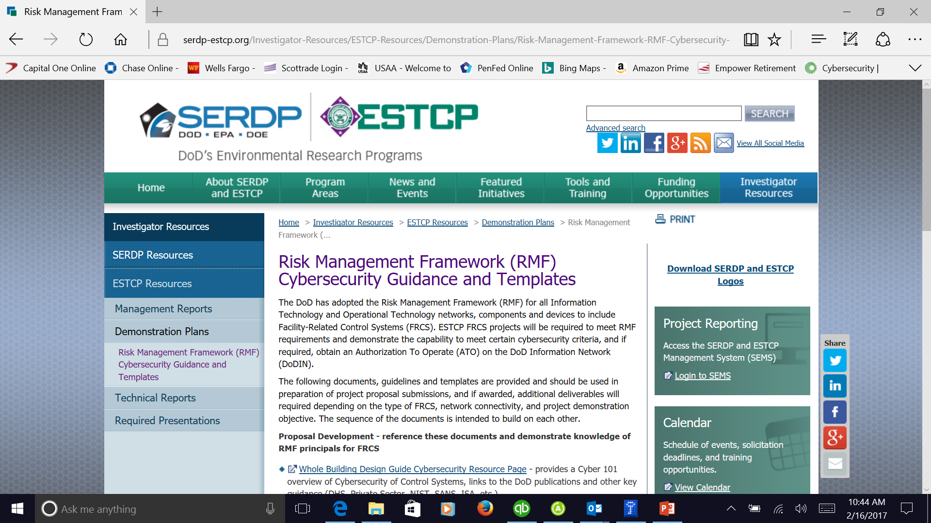
ESTCP RMF Cybersecurity Guidance
For the FY 2017/18 program, new Cyber Guidance has been incorporated into contracting language and defines new processes to follow to deliver cybersecure control systems: https://serdp-estcp.org/Investigator-Resources/ESTCP-Resources/Demonstration-Plans/Cybersecurity-Guidelines

Slide 17
Contact
Tim Tetreault
ESTCP Energy and Water Program Manager
Timothy.j.Tetreault.civ@mail.mil
571-372-6397

Slide 18


THANK YOU
CS2AI Confidential

