Slide 1
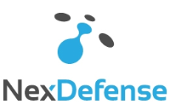






PLATINUM
GOLD
SILVER/
CHAPTER
Notes:
The Energy and Water Program covers a wide array of technologies that are applicable to use and management of energy and water on military installations. The technologies are organized in three main areas of focus. The first is “Smart and Secure Installation Energy Management”, which includes…, the Second is Efficient Integrated Buildings and Components, which includes…tech and tools that…and the Third is “Distributed Generation”, which includes renewables, waste heat recovery and CHP.

Slide 2


THANK YOU
CS2AI Confidential

